Slide 1
Predicting Severity of Vehicle Accident
Capstone Project
IBM Course on Coursera

Slide 2
Time is the critical variable.
If a road accident information can be used to predict the severity of the accident before emergency personnel arrive at the accident site
Such a system can save lives if the authorities and the care givers are equipped with such predictive power.
This system will not only save lives, but also a proper allocation of resources can be implemented.
This will improve the rating of the city, and thereby more businesses and people would like to stay in the city.

Slide 3
Data Acquisition and Cleaning
Seattle Police Department (SPD) generates the data
The is updated every week since 2004
A lot of metadata and index columns are part of the data
There are missing values in almost every variable, and was able to accommodate missing values into the model
From 38 variables that are available in the dataset, I was able to capture 13 variables to be used in the model.
Had to do cleaning, binning and in some cases, re-grouping.

Slide 4
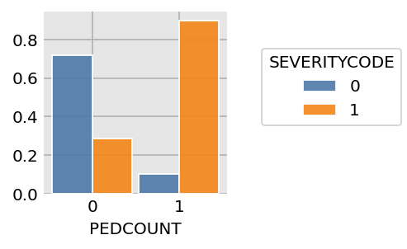
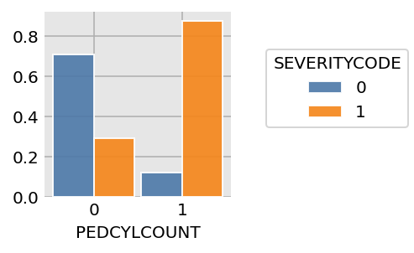
Pedestrians and Pedal Cyclists are at Risk
The average injury rate is 30% but if a pedestrian is involved in the accident, then the injury rate is 90%
Similarly if a cyclist is involved then there are 88% chance of being injured

Slide 5
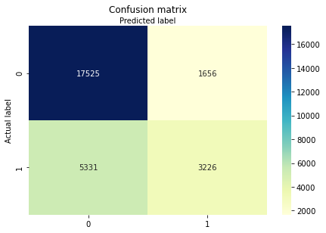
Logistic Regression for a Classification Problem
Accuracy: 75%
Precision: 66%
Recall: 37%
ROC Curve Area Under the Curve: 78%
Easy to implement, understand and maintain.

Slide 6
Conclusion and Future Direction
The model should be calibrated from time to time
Implementation into the production should be handled with people with knowledge of data treatment.
With the advent of new technologies, the data capture should be more accurate.
I recommend segmenting the data to have multiple targeted models.

